Slide 1
NeedlePath: Facilitating Out-of-Plane CT-Guided Needle Placement
Phillip Cheng, MD MS

Slide 2
Purpose
This presentation discusses out-of-plane needle placement procedures, and the difficulties of current strategies for these procedures.
We describe how a new open source software program called NeedlePath can help make these procedures easier.

Slide 3
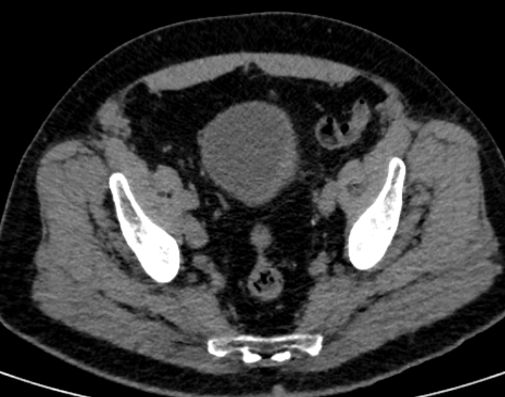
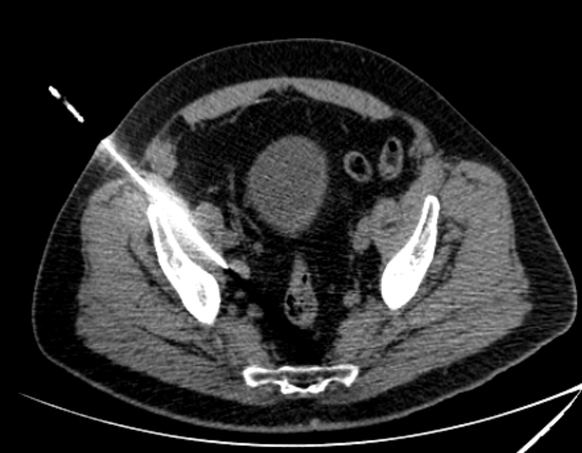
CT-Guided Needle Placement
CT-guided needle placement is a common initial task for interventional procedures (e.g. biopsy, drainage, injection, fiducial placement, ablation)
Usually, the body entry point and target can be imaged in the same axial plane (“in-plane”)
Needle adjustments for in-plane procedures are straightforward, since the distance and angle can be visualized on one image

Slide 4
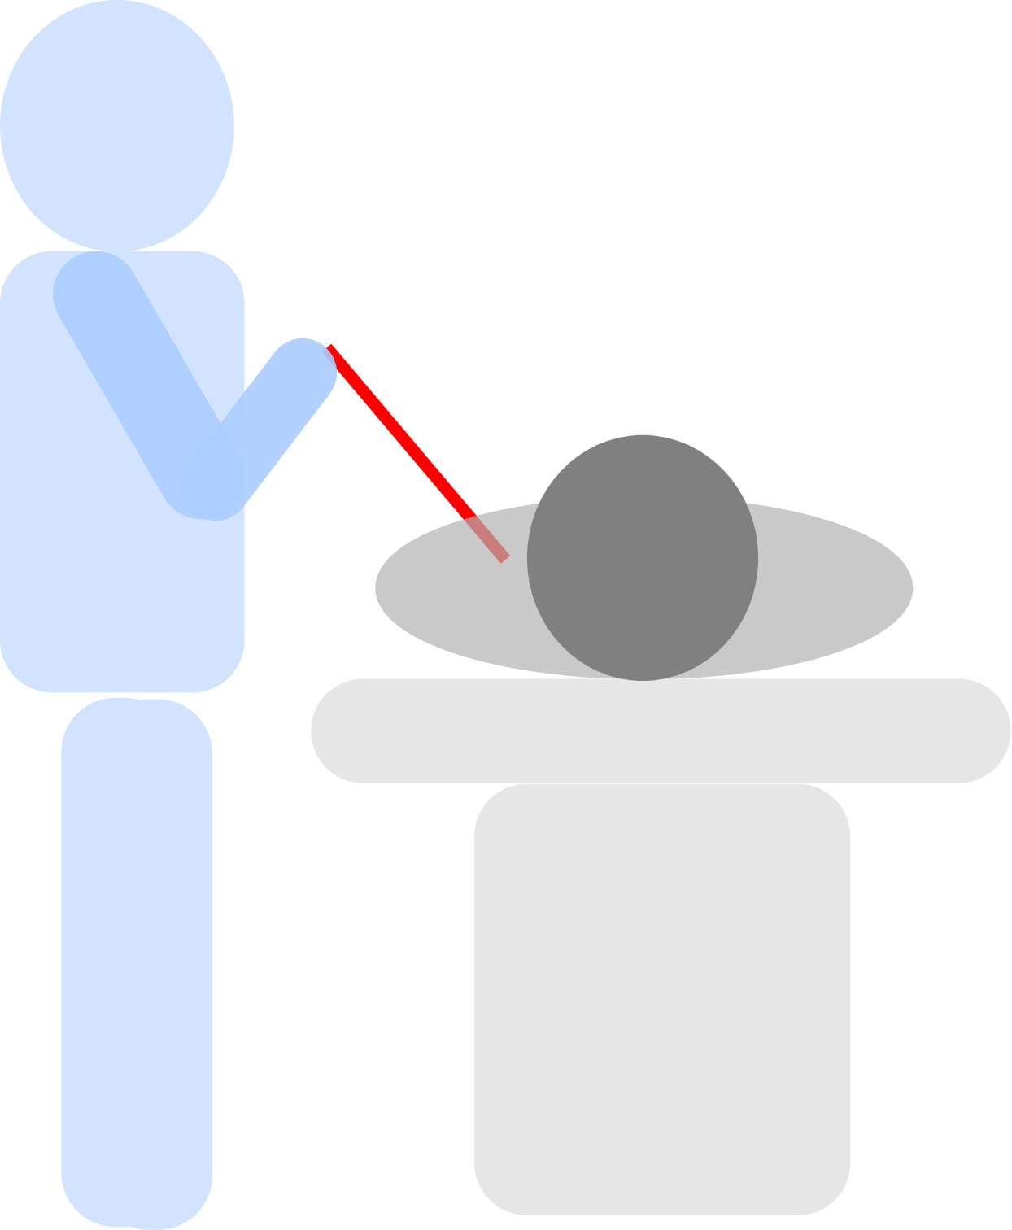
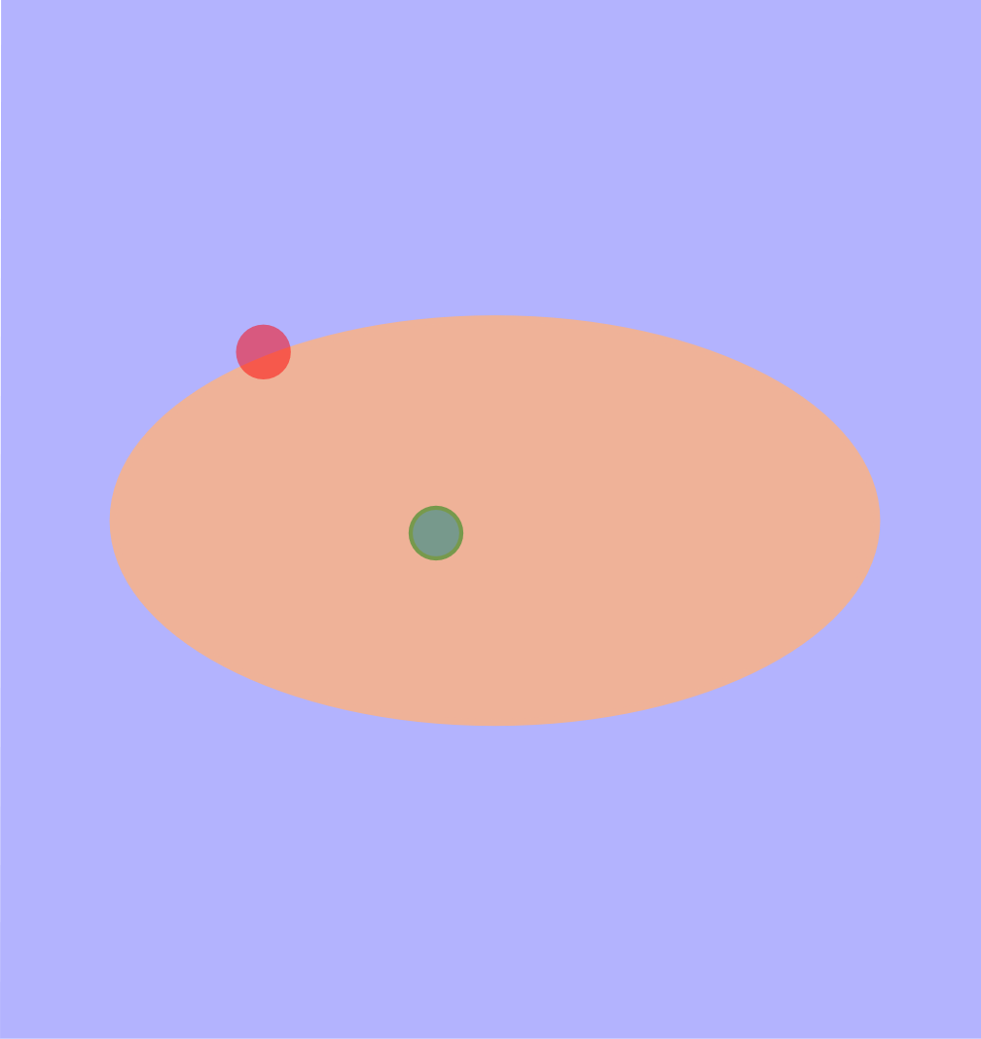
In-plane Procedure
Start
θ
θ
d
Target
In an in-plane procedure, the target is specified relative to the entry point by a single angle (the in-plane angle θ) and the straight-line distance d.

Slide 5
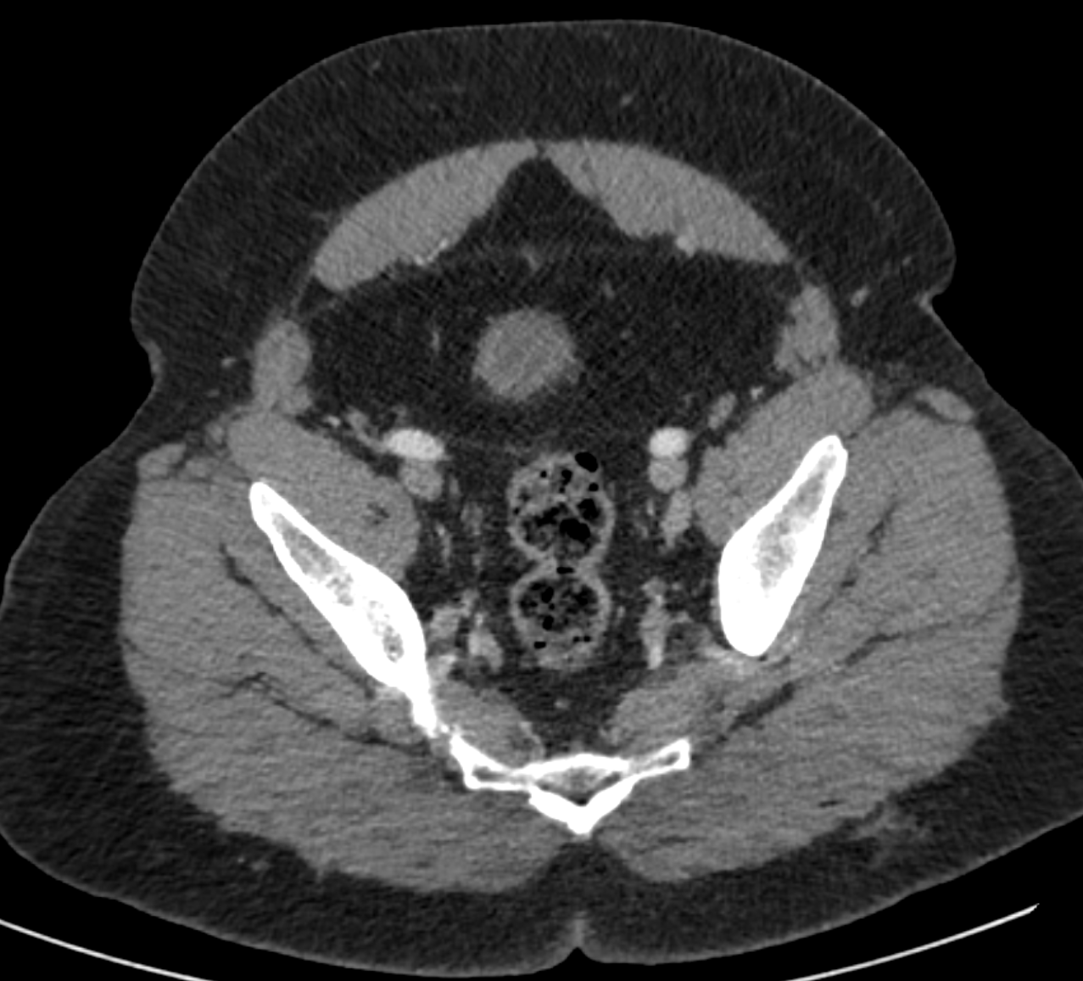
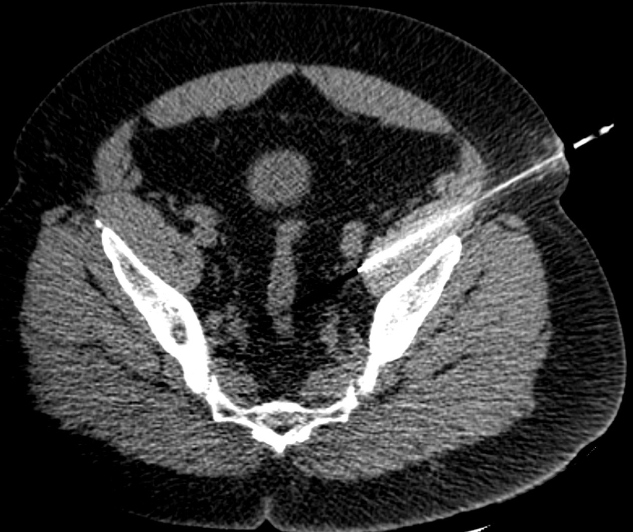
In-plane Procedure Example
θ
In this in-plane biopsy of a left external iliac node, the entire needle path from body entry site to target can be visualized on a single image. The in-plane angle θ can be directly visualized, and angle adjustments are easily made.

Slide 6
Out-of-plane Procedures
An in-plane needle trajectory may not be possible due to intervening structures (e.g. lung, bowel, bone)
Possible strategies
Reposition patient so that target is “in-plane”
possible only for some targets
CT gantry tilt
“Dead reckoning” – visual estimation of the required out-of-plane needle trajectory, with slow careful advance of the needle

Slide 7
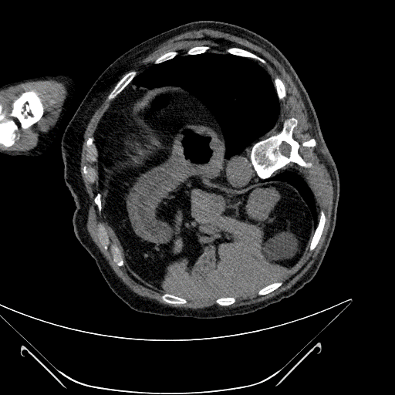
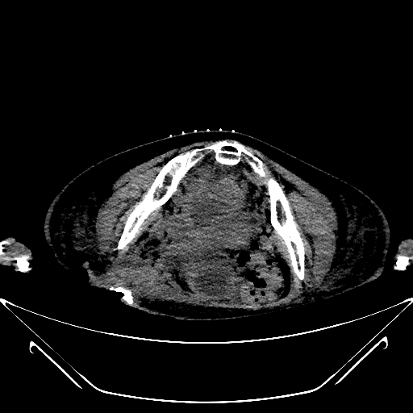
Out-of-plane Targets
Right renal mass
Pelvic abscess
*
Right renal upper pole mass is not accessible in-plane due to intervening lung (*) despite decubitus positioning.
Central pelvic abscess is not accessible in-plane due to surrounding bone.

Slide 8
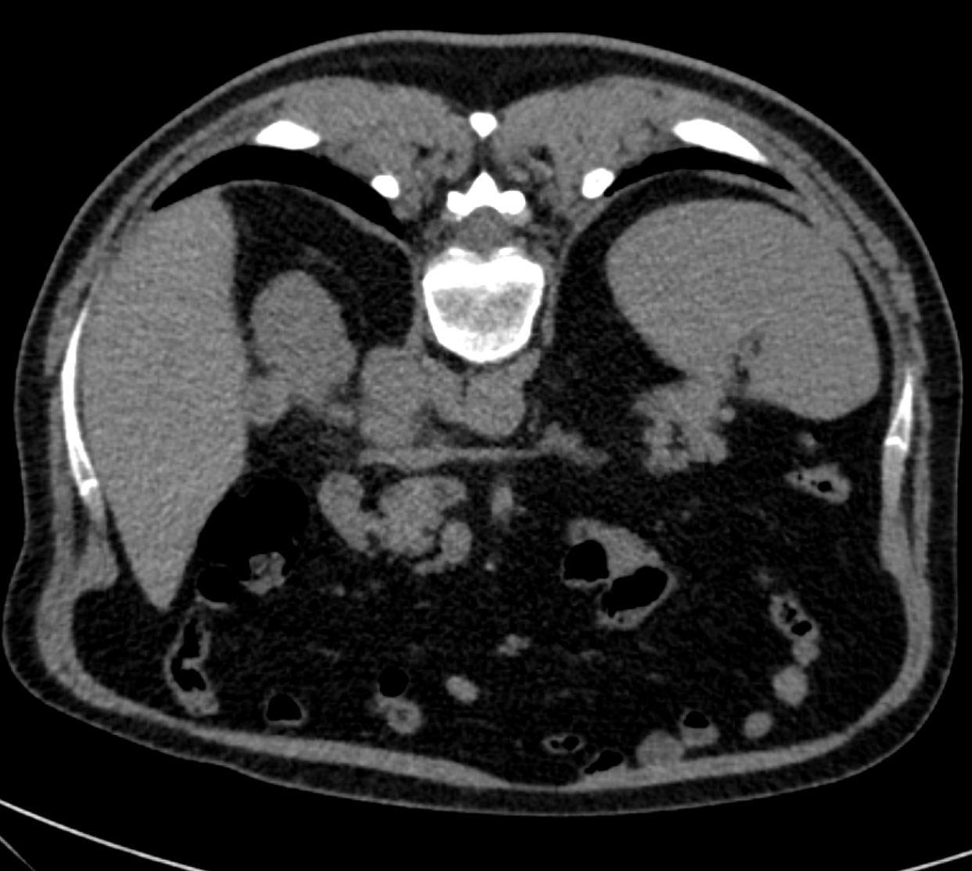
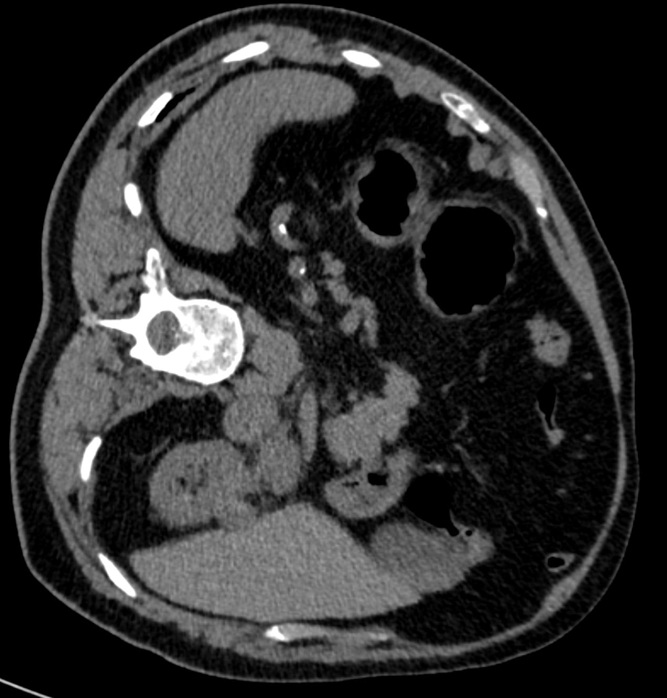
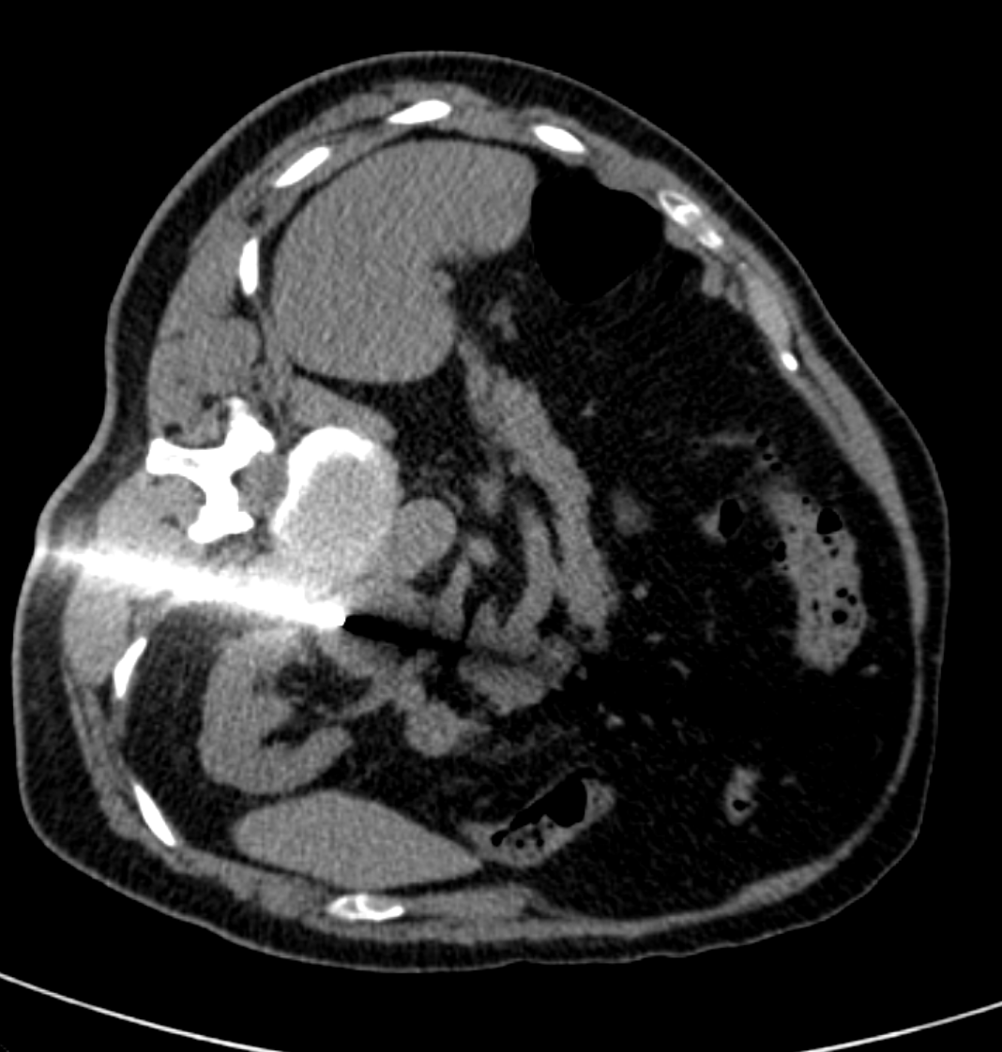
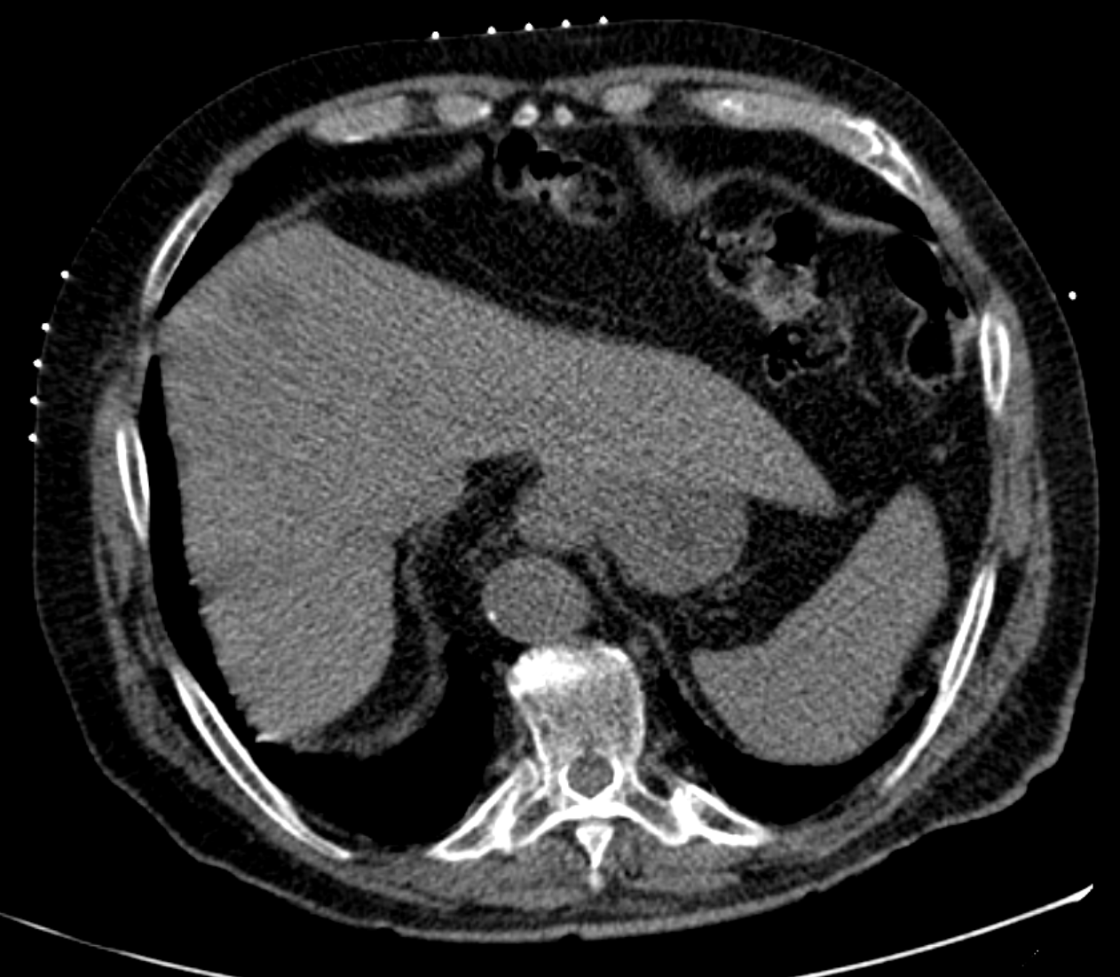
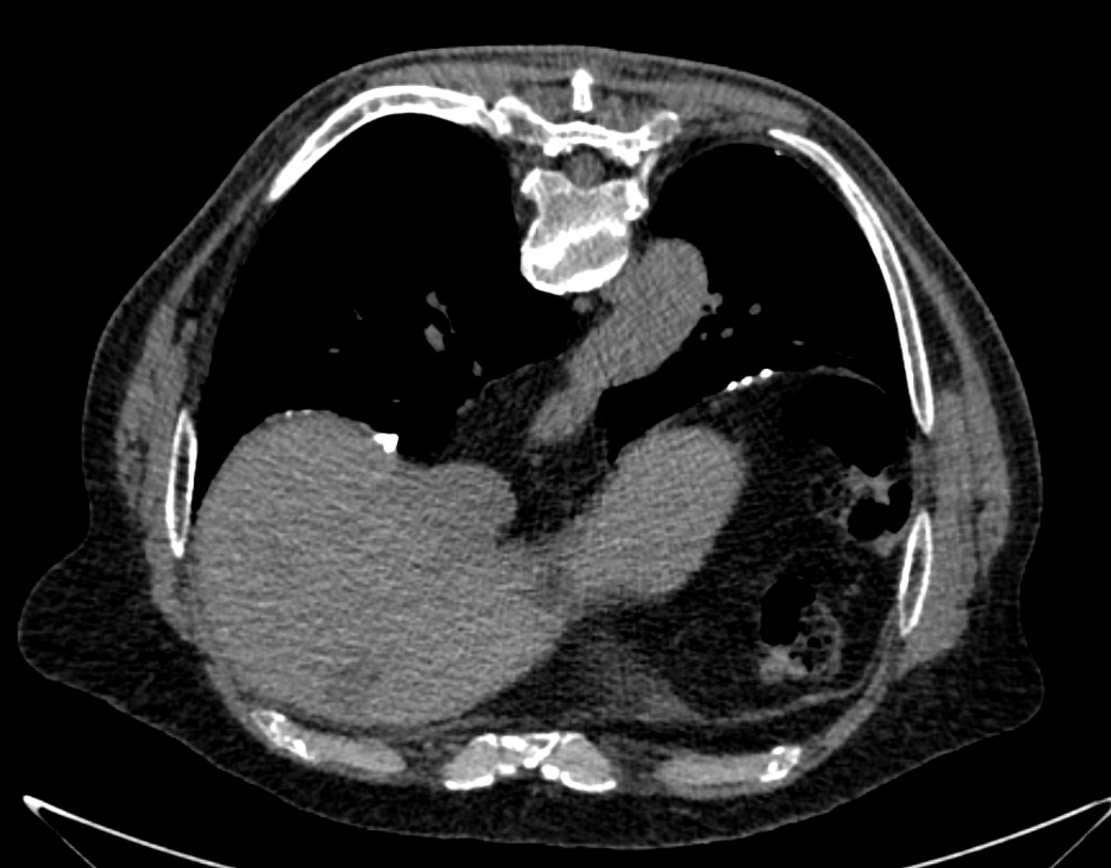
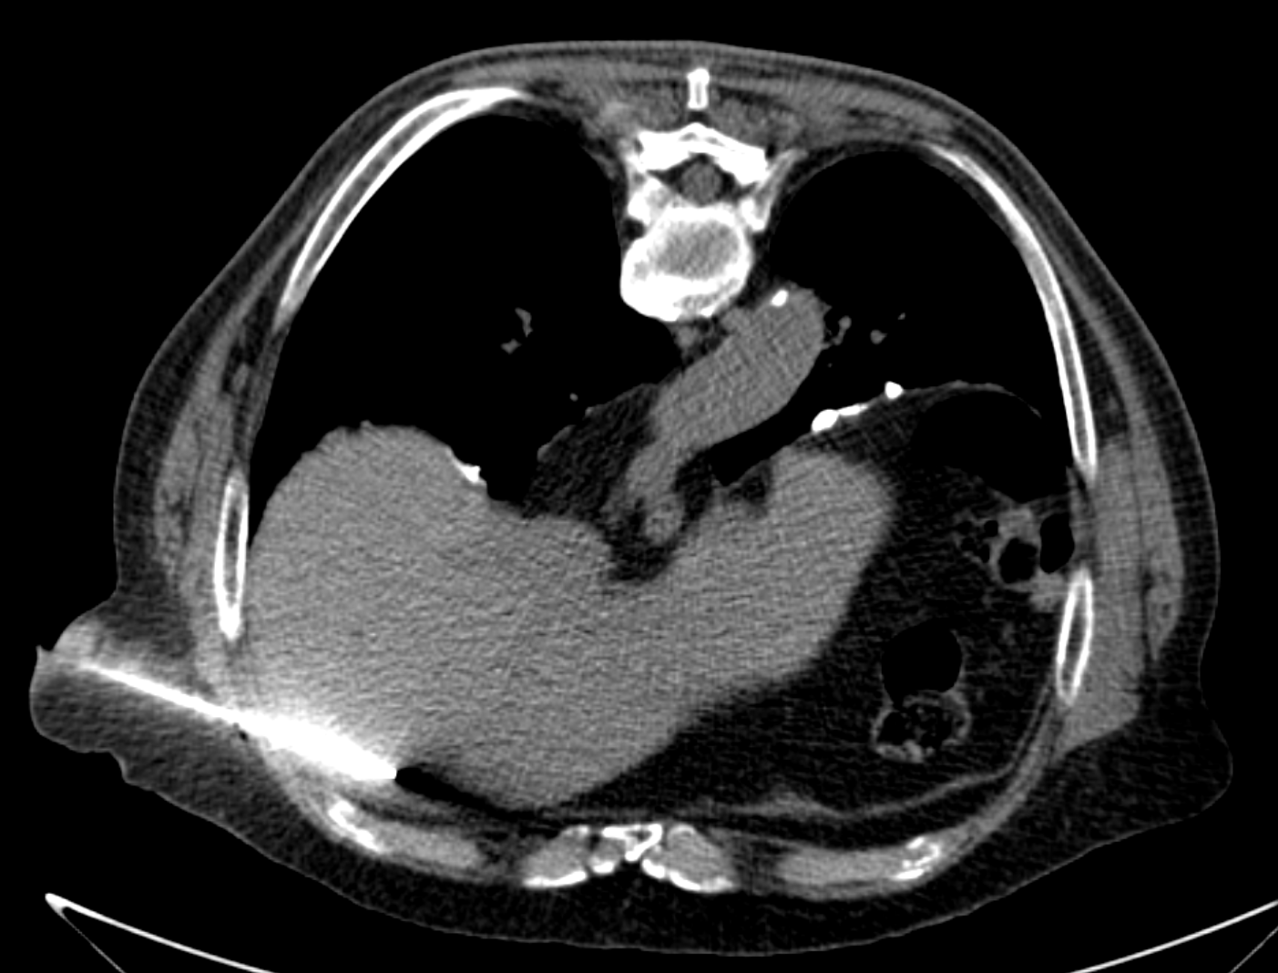
Patient Repositioning
Right adrenal mass is not accessible with patient prone due to intervening lung (*). Right lateral decubitus positioning reduces lung excursion, allowing in-plane access.
*
*
*
Superior right hepatic lobe mass is not accessible with patient supine due to surrounding lung (*). Prone positioning allows successful in-plane access.

Slide 9
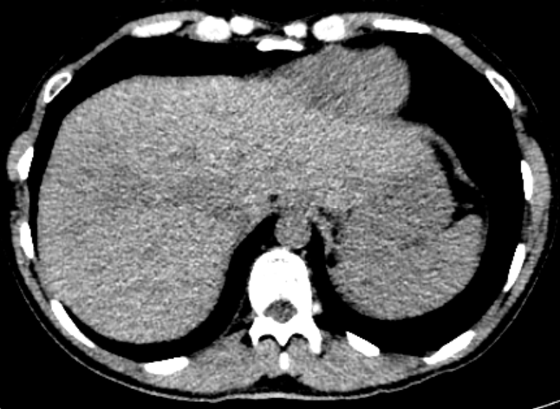
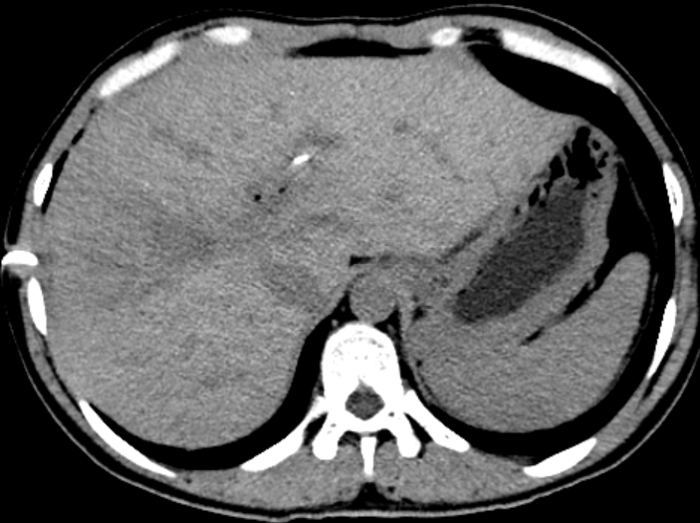
CT Gantry Tilt
*
*
Initial supine positioning shows an ill-defined liver target with intervening lung (*) preventing in-plane access.
CT gantry tilt of 15° excludes lung around the anterior aspect of the liver, allowing subsequent successful biopsy via the indicated trajectory.

Slide 10
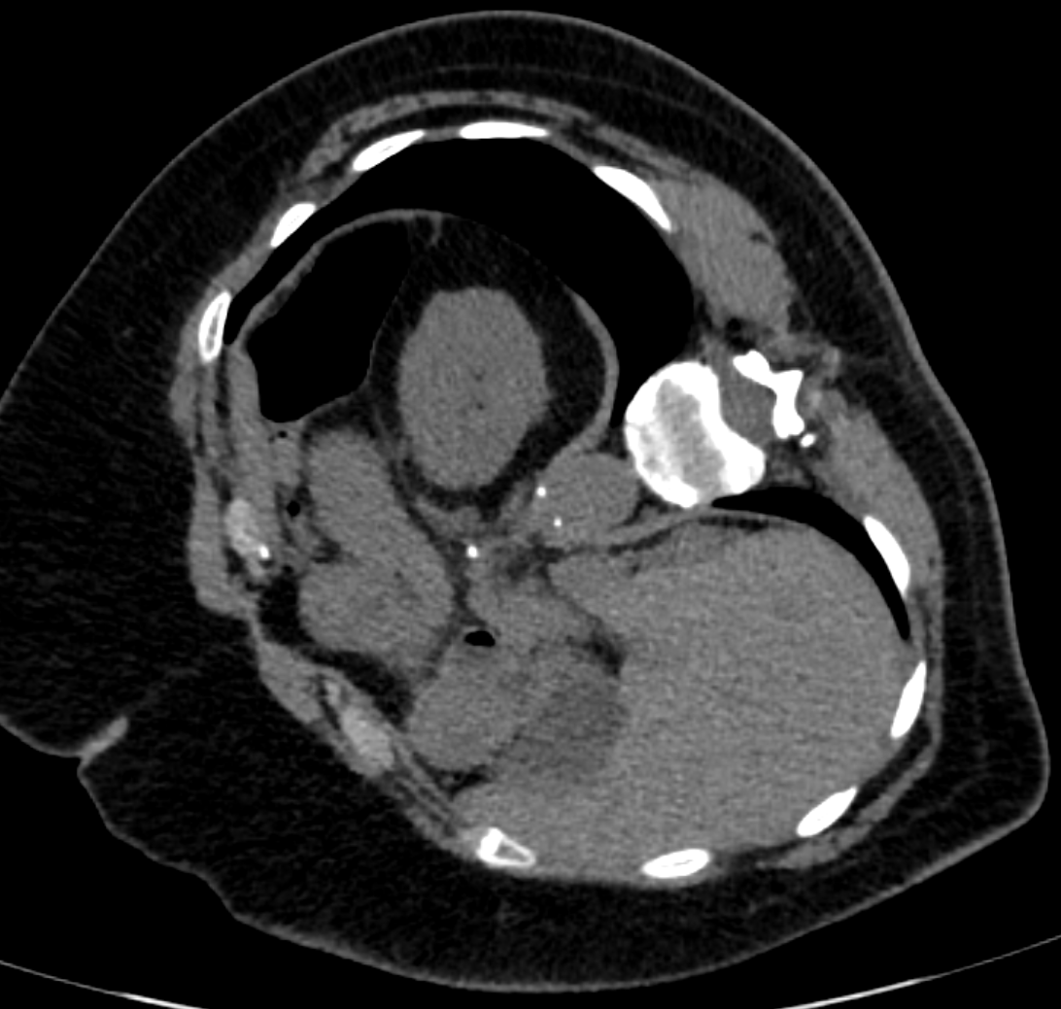
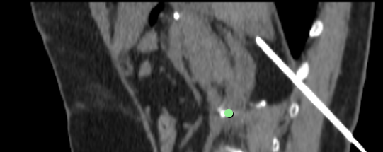
“Dead Reckoning”
*
Sagittal oblique reformat. The adrenal nodule was successfully biopsied using careful needle advancement and a steep out-of-plane trajectory avoiding the lung (*).
The out-of-plane needle angle in this difficult case was 46° relative to the axial plane, beyond the maximum gantry tilt of most CT scanners.
Right lateral decubitus positioning shows an adrenal nodule with intervening lung (*) preventing in-plane access.

Slide 11
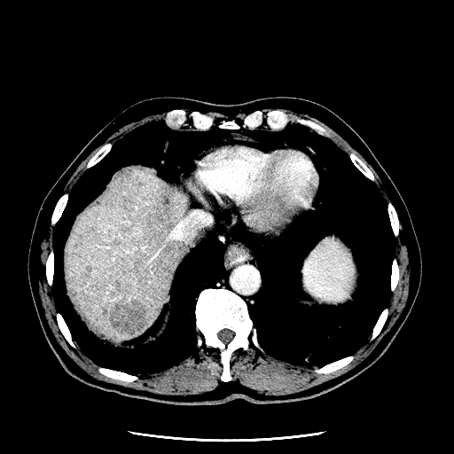
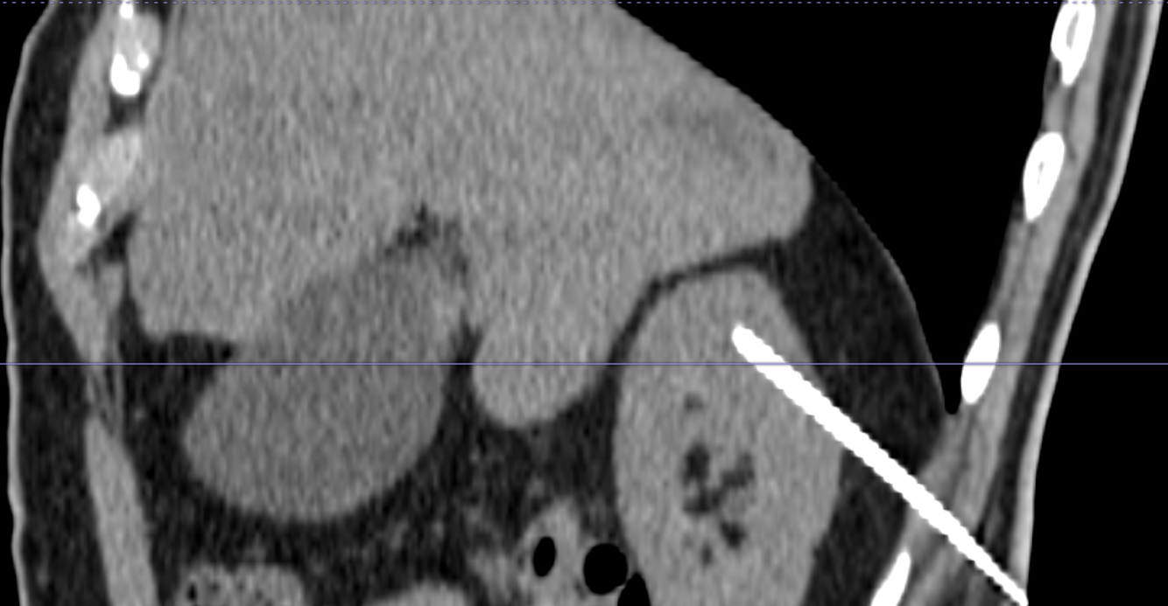
“Dead Reckoning” Complication
CT biopsy of out-of-plane targets by “dead reckoning” can be challenging.
Target liver mass
*
Target
*
Sagittal image from CT biopsy by an inexperienced operator using “dead reckoning” resulted in inadvertent placement of the needle in the right kidney. The needle was removed and eventually successfully positioned.
A high right hepatic lobe mass is not accessible on CT in-plane due to intervening lung (*).

Slide 12
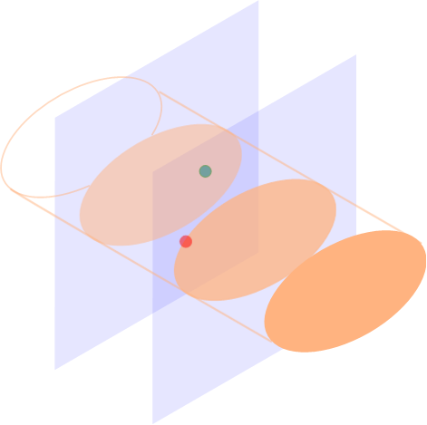
Out-of-Plane Procedure Geometry
While “dead reckoning” may be successful in out-of-plane procedures, it can be tedious and prone to error.
Let us consider more carefully the geometry of an out-of-plane procedure, where the body entry point is on a different slice from the target.
Target slice
Start slice

Slide 13
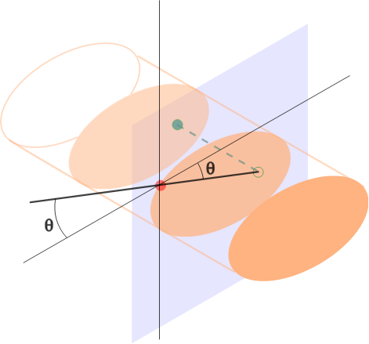
In-plane Angle for Out-of-plane Procedure
By projecting the target onto the start slice, we can calculate the in-plane angle θ, as if the target was in the starting slice.
Start slice

Slide 14
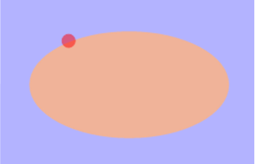
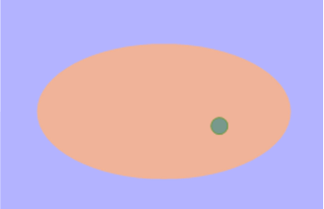
In-Plane Angle Calculation
The in-plane angle θ is calculated by simple trigonometry.
Start (x₁, y₁, z₁)
Start slice
Target (x₂, y₂, z₂)
Target slice
Target Projection (x₂, y₂, z₁)
Δx
θ
$$Δx=\left|x_{2}−x_{1}\right|$$
$$Δy=\left|y_{2}−y_{1}\right|$$
In-plane angle $θ{=\tan^{−1}{\frac{Δy}{Δx}}}$
Δy

Slide 15
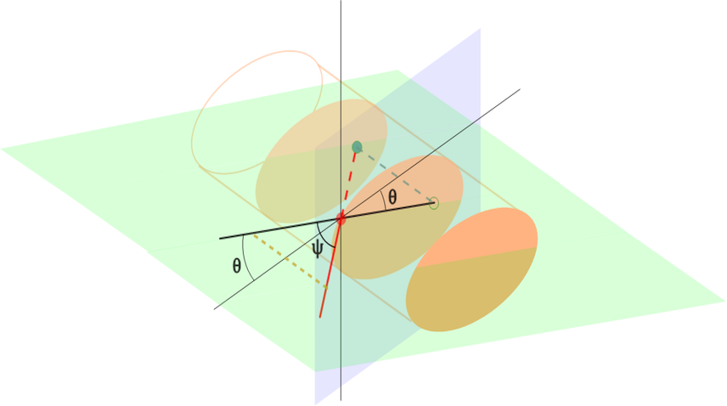
Out-of-Plane Angle
The start point, target point, and target projection together define a plane in which we can measure the out-of-plane angle ψ.
The angle ψ is
obtained by simple trigonometry (next slide).
Angles θ and ψ are related to the azimuthal and polar angles in spherical coordinate geometry.

Slide 16
Out-of-Plane Angle Calculation
Start (x₁, y₁, z₁)
Target (x₂, y₂, z₂)
Target Projection (x₂, y₂, z₁)
Target slice
$$Δx=\left|x_{2}−x_{1}\right|$$
$$Δy=\left|y_{2}−y_{1}\right|$$
$$Δz=\left|z_{2}−z_{1}\right|$$
3-D distance $ρ=\sqrt{{(\left(Δx\right)}^{2}+{\left(Δy\right)}^{2}+{\left(Δz\right)}^{2}}$
Out-of-plane angle $ψ{=\sin^{−1}{\frac{Δz}{ρ}}}$
ρ
Δz
Start slice
ψ

Slide 17
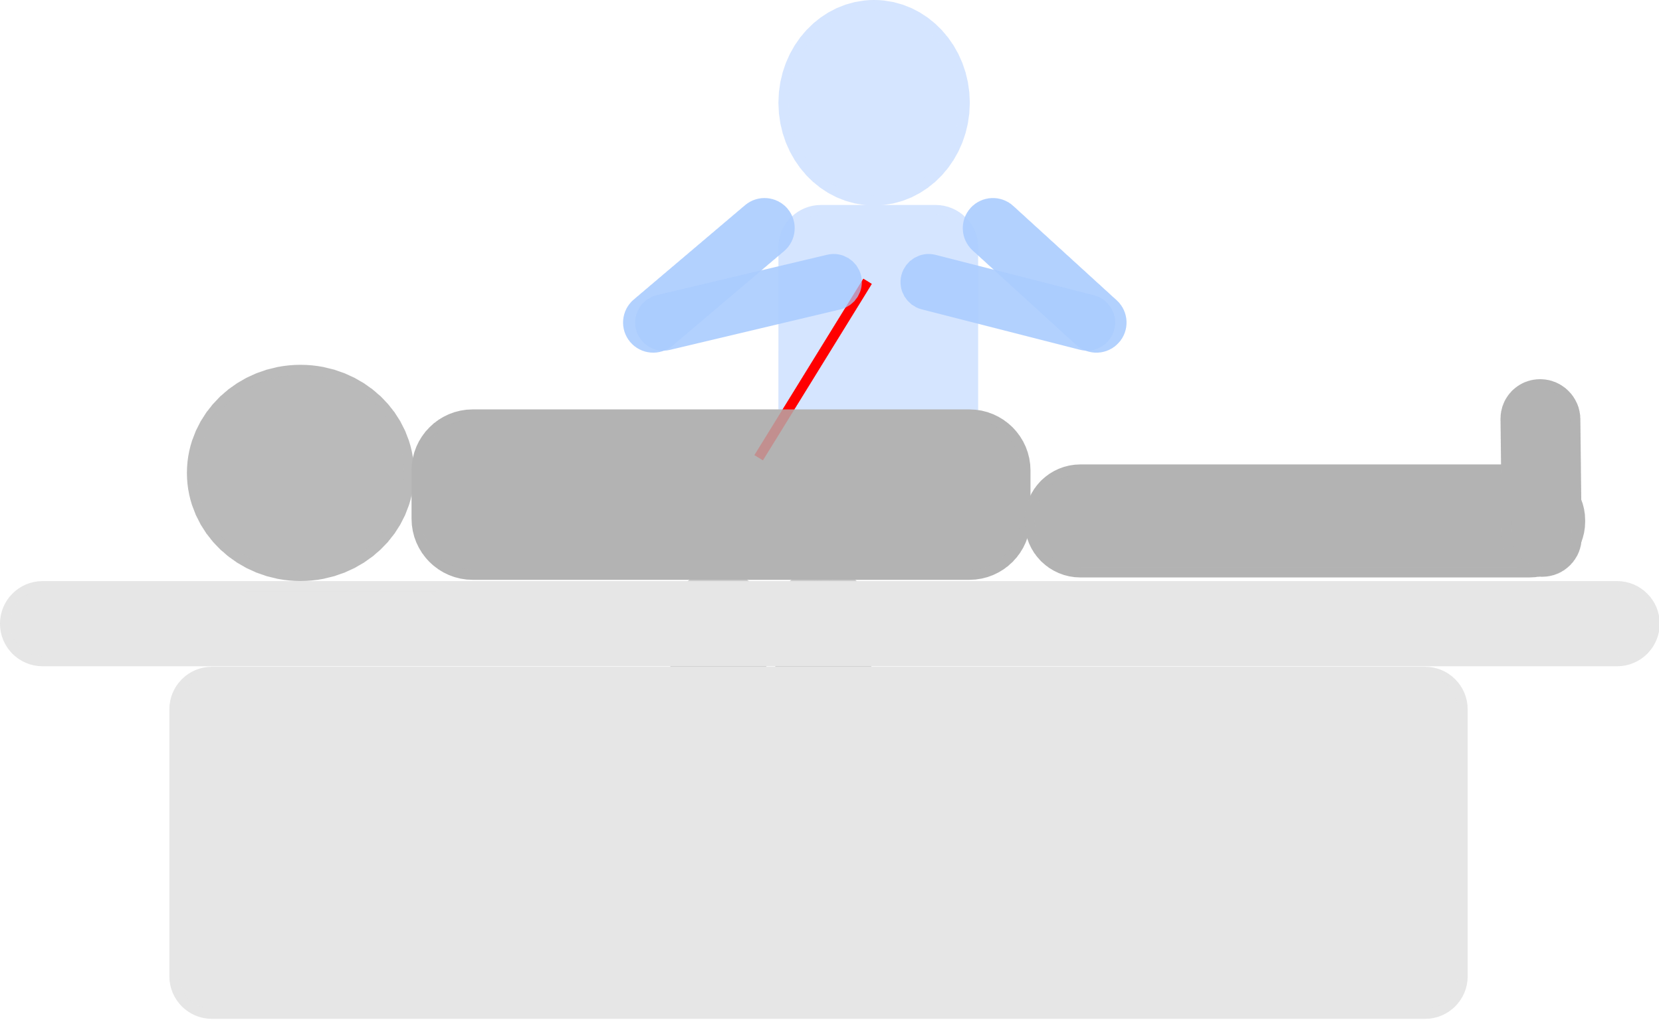
Out-of-plane Angle
ψ
θ
For out-of-plane needle placement, one can follow the following steps:
tilt the needle to the required in-plane angle θ relative to the horizontal axis
tilt the needle to the required out-of-plane angle ψ relative to the axial plane
advance the needle by the 3-dimensional straight-line distance ρ
Unfortunately, these required quantities for an out-of-plane target (θ, ψ, ρ) are typically not easy to measure on the scanner console or PACS software.

Slide 18
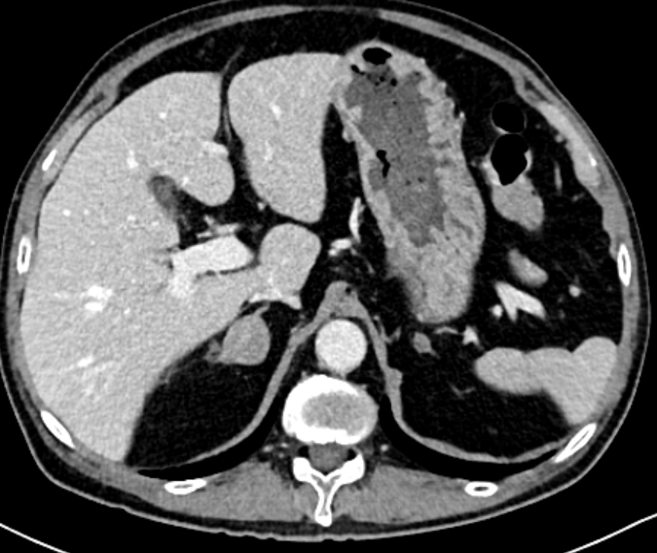
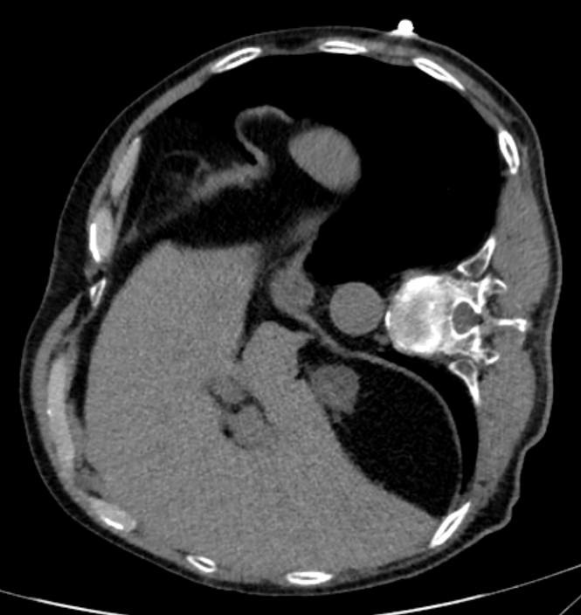
NeedlePath
*
NeedlePath is a program designed to automate calculation and display of needle trajectories for out-of-plane CT procedures.
To illustrate the usage of NeedlePath, we use the above example of an out-of-plane right adrenal nodule biopsy. Right lateral decubitus positioning does not reveal an in-plane path due to intervening lung (*).

Slide 19
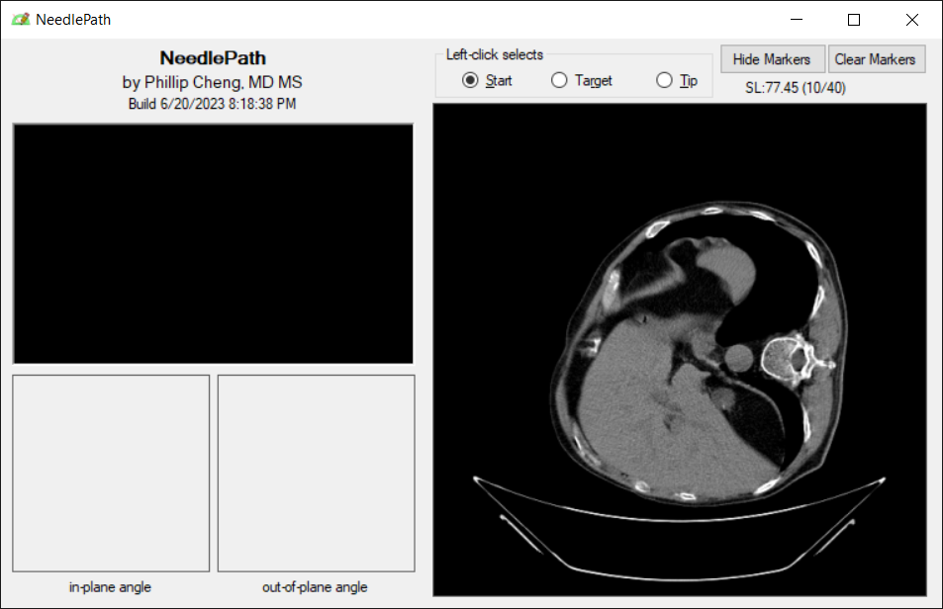
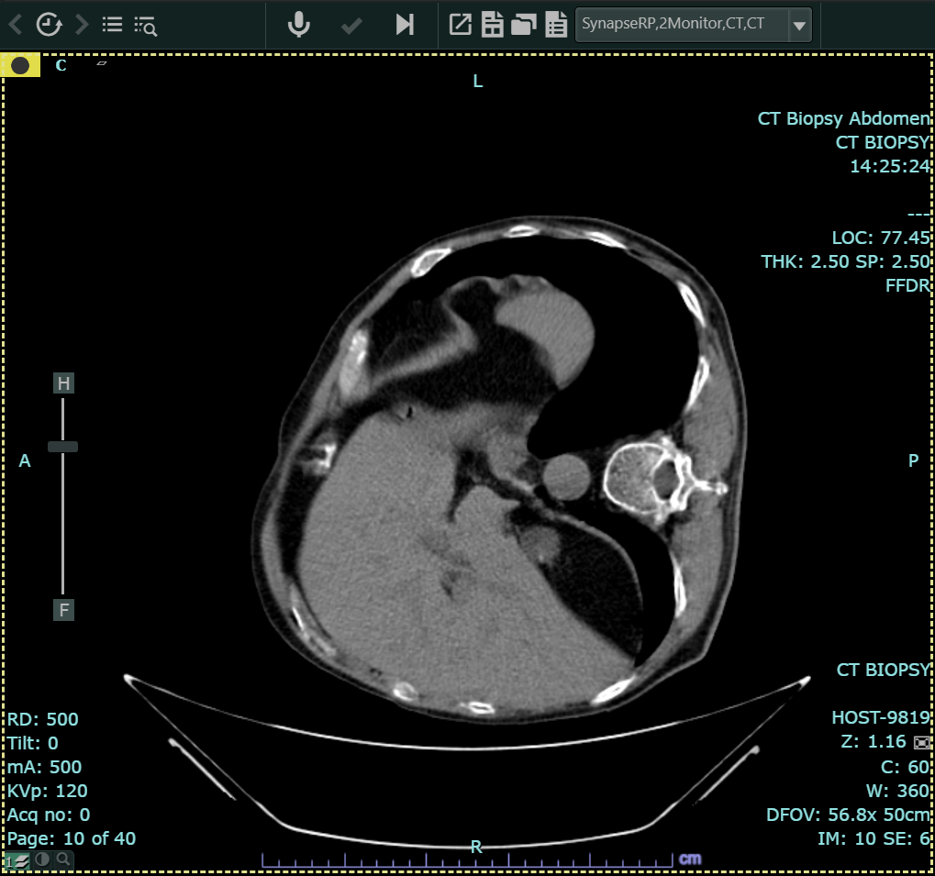
Image Series Transfer
NeedlePath Window
Synapse PACS Window
Drag
The first step is to drag an axial image series from PACS to NeedlePath.
The drag-and-drop operation conveys a unique study ID and series ID to NeedlePath, which then uses this information in a web API call to retrieve the DICOM image series from the Fuji Synapse PACS.

Slide 20
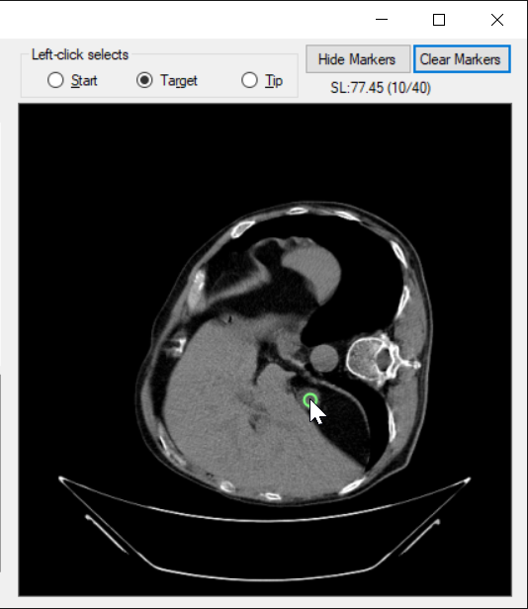
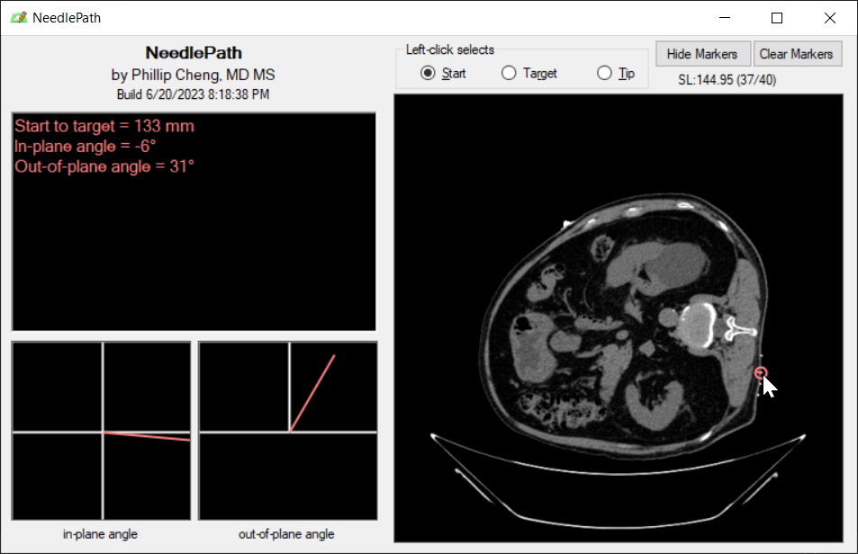
Start and Target Selection
Left-clicking on points in the image series allows selection of the target and a candidate start point.
The program calculates the 3D distance (ρ), the in-plane angle (θ), and the out-of-plane angle (ψ).
This is a visual display of the in-plane angle (θ) and out-of-plane angle (ψ).

Slide 21
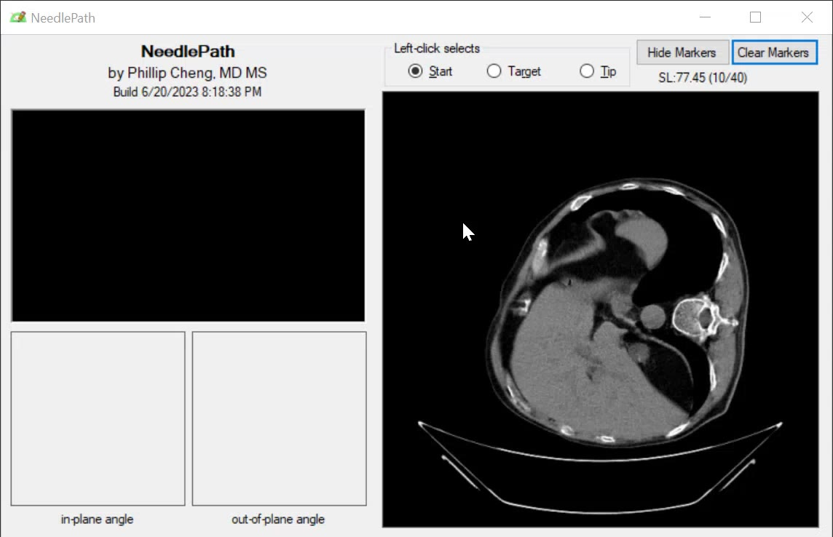
Start and Target Selection
After selecting the start point and target, NeedlePath shows the projected course of the needle so that the user can scroll through the images and verify that the path is safe.
(video demonstration on next slide)

Slide 22
Procedure Angles
Though the patient is lying in a left lateral decubitus position, remember that the angles are measured in a fixed frame of reference relative to the scanner.
The in-plane angle θ is measured relative to the horizontal axis.
θ=–6°
“Axial” view
Top view
The out-of-plane angle ψ is measured relative to the axial plane.
ψ=31°

Slide 23
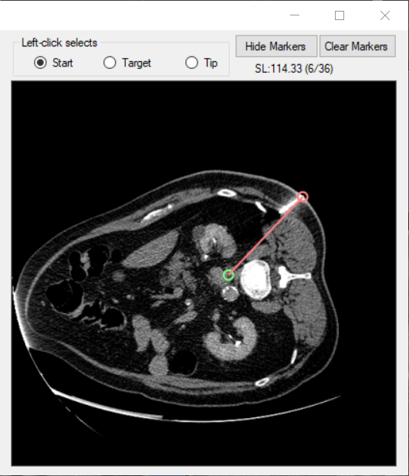
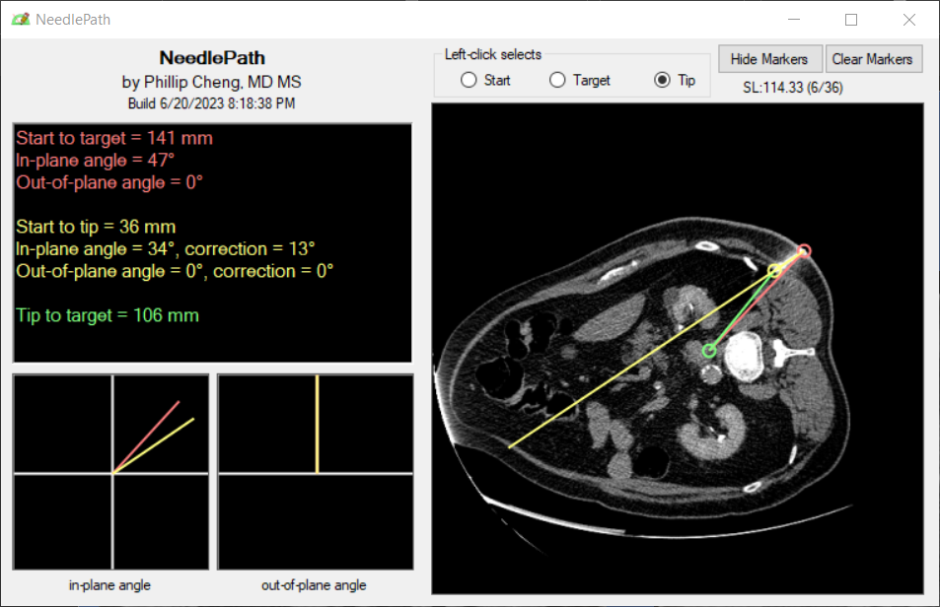
Angle Corrections
Once a needle has been placed, the user can mark the needle tip to calculate angle corrections. We can illustrate this more easily on this in-plane aortocaval node biopsy, where only an in-plane angle correction is needed.
The needle angle is more shallow than the path to the target node.
Clicking the needle tip shows that the needle angle should be tilted by 13° at the entry site.

Slide 24
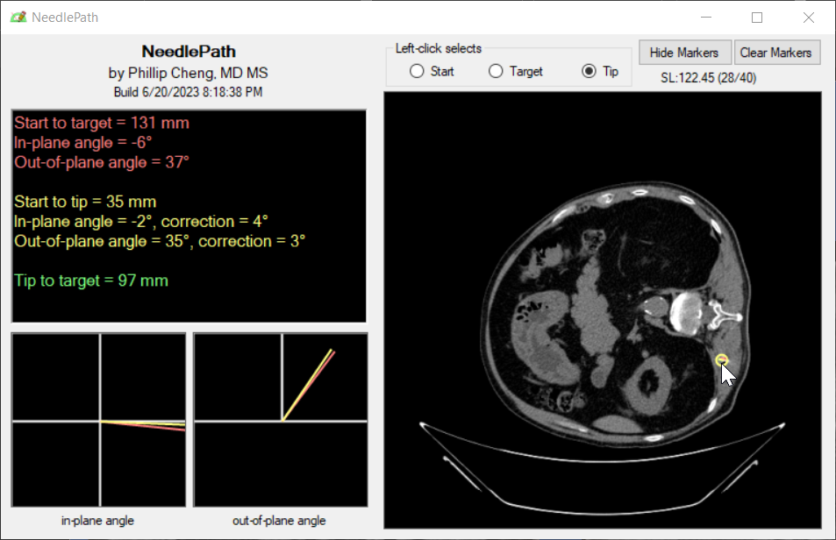
Angle Corrections
In the case of the right adrenal nodule biopsy, the initial needle placement is nearly exactly on target, with only small angle corrections required in-plane (4°) and out- of-plane (3°).

Slide 25
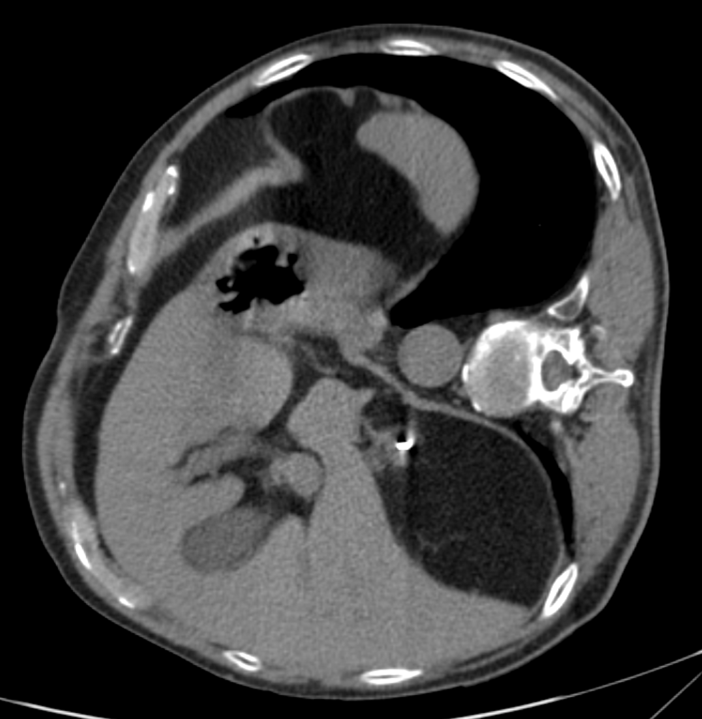
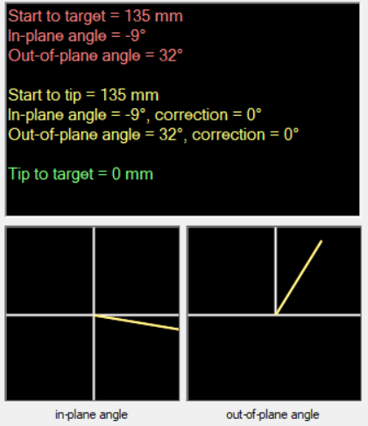
Procedure completion
The biopsy procedure was completed successfully and uneventfully, using NeedlePath to check the needle angles and distance at each intermediate scan.
Note that the final needle angles differ slightly from the initially calculated values, likely due to slight changes in the patient position during the procedure.

Slide 26
Future Steps
NeedlePath is currently undergoing prospective evaluation on out-of-plane procedures at our institution as an IRB-approved research project.
Since the functionality of NeedlePath is simple, it could ideally be included in the CT scanner console software or in the PACS.

Slide 27
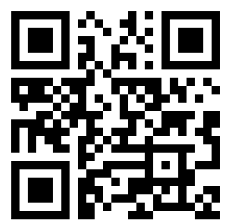
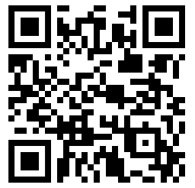
Summary
Out-of-plane CT-guided needle placement can be challenging!
NeedlePath, an open source desktop application, may help make these procedures easier and safer.
https://pcheng.org/needlepath
GitHub source code
phillip.cheng@med.usc.edu

